Slide 1
Lecture 17: Model of the atom
California State University, Fullerton
2023 Fall Semester – Chem 123

Slide 2

QUESTIONS, COMMENTS, AND CONCERNS?

Slide 3
Outline
Announcements
Ch. 8: Model of the Atom
Introduction to Light Energy
Bohr Model of the Atom
Heisenberg Uncertainty Principle
Atomic Orbitals and Quantum Numbers
Electron Configuration

Slide 4
announcements
Still grading exam 2
Online Ch 8+9 Hw is posted and due Nov 7th at 11:59pm
Exam 3 coming up Weds, Nov 15th covering Chs 8-10, and part of 11

Slide 5
Outline
Announcements
Ch. 8: Model of the Atom
Introduction to Light Energy
Bohr Model of the Atom
Heisenberg Uncertainty Principle
Atomic Orbitals and Quantum Numbers
Electron Configuration

Slide 6
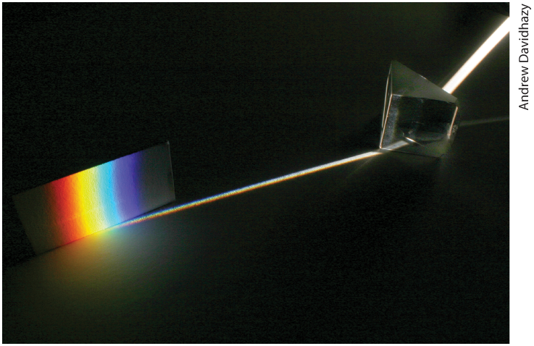
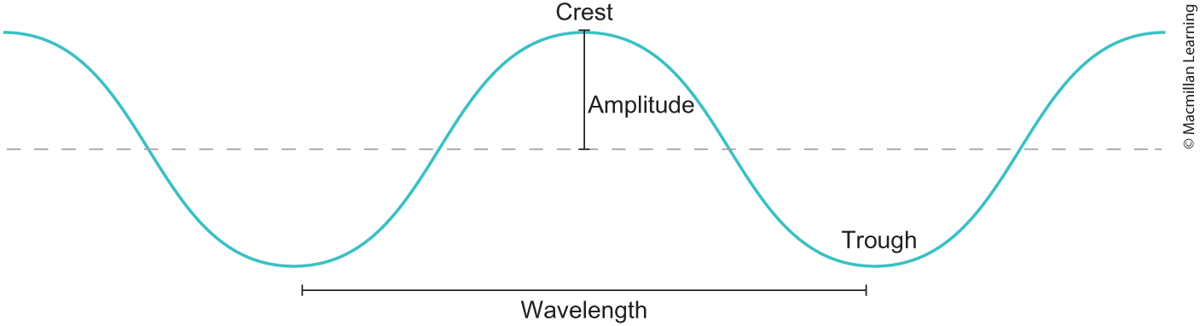
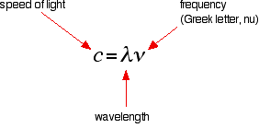
Introduction to light
What is light?
A form of energy and described as wave traveling through space
c = 3.00 x 10⁸ m/s
Wavelength is in m
Frequency is in Hs (1/s)

Slide 7
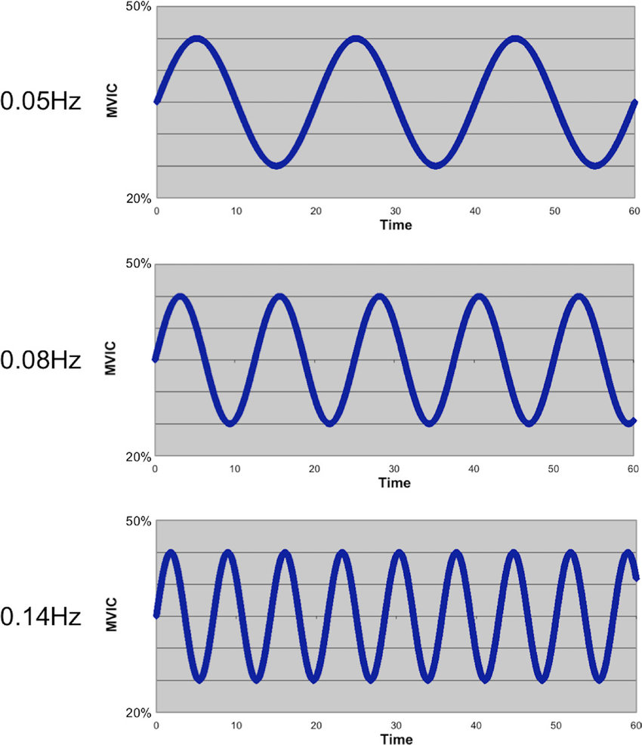
Fast and slow frequency

Slide 8
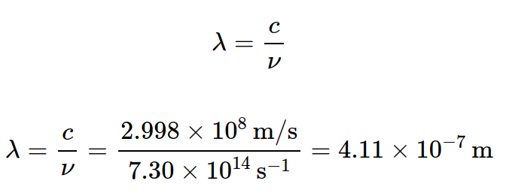
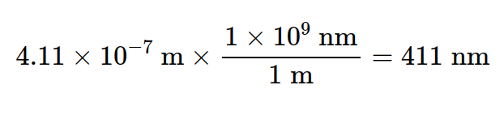
Example: calculating wavelength
Calculate the wavelength of light that corresponds to a frequency of
7.30 x 10¹⁴ Hz. Report your answer in units of nm. (1 m = 1 x 10⁹ nm)

Slide 9
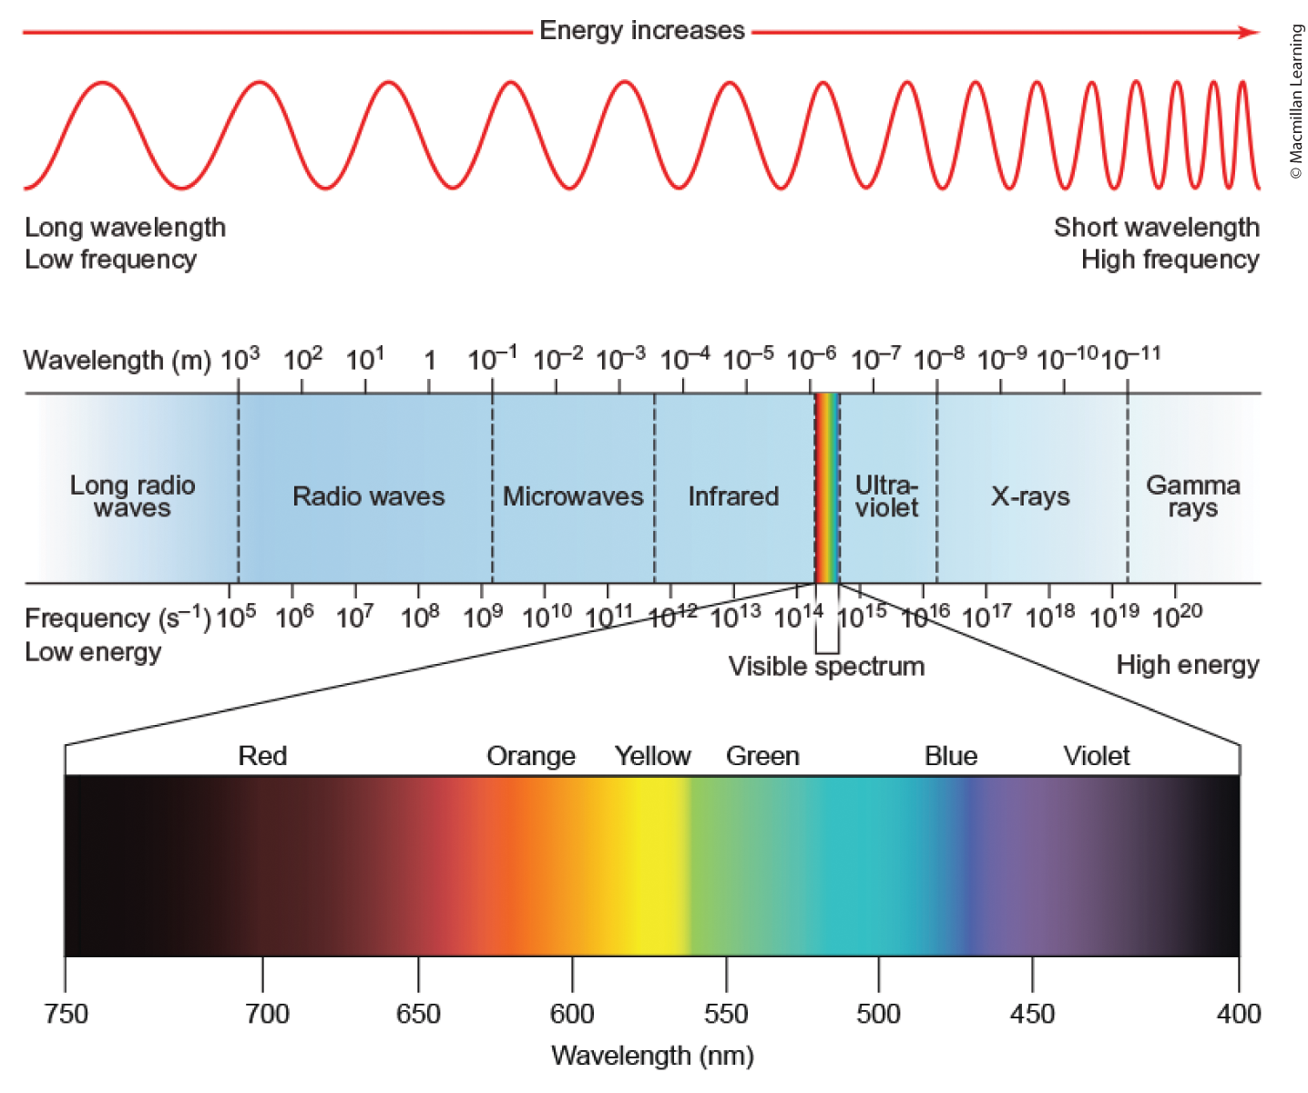
Energy of electromagnetic radiation

Slide 10
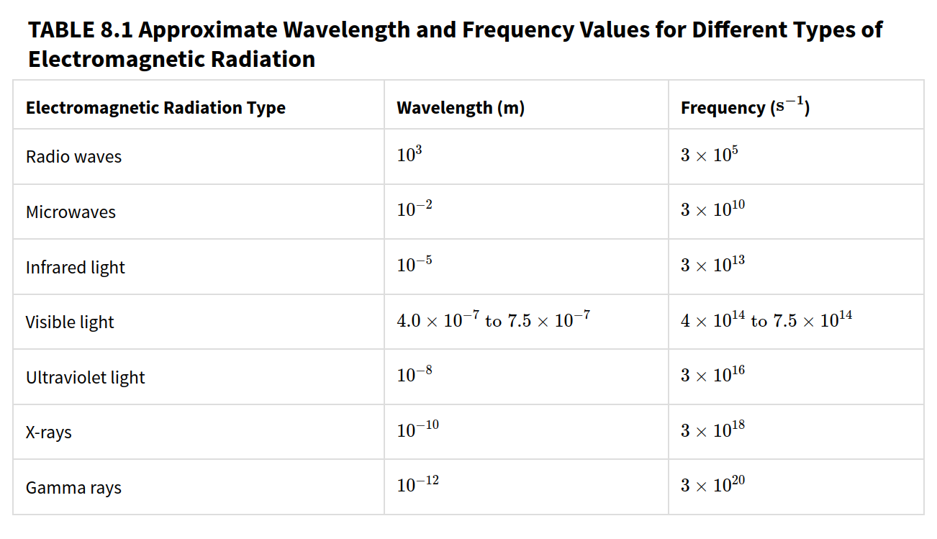
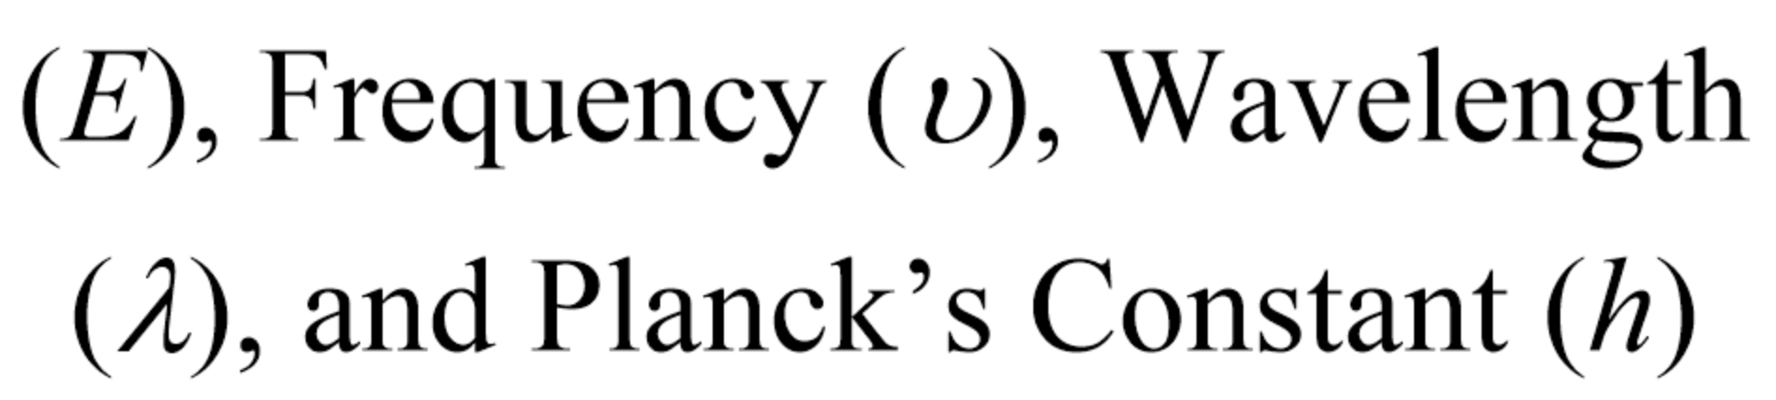
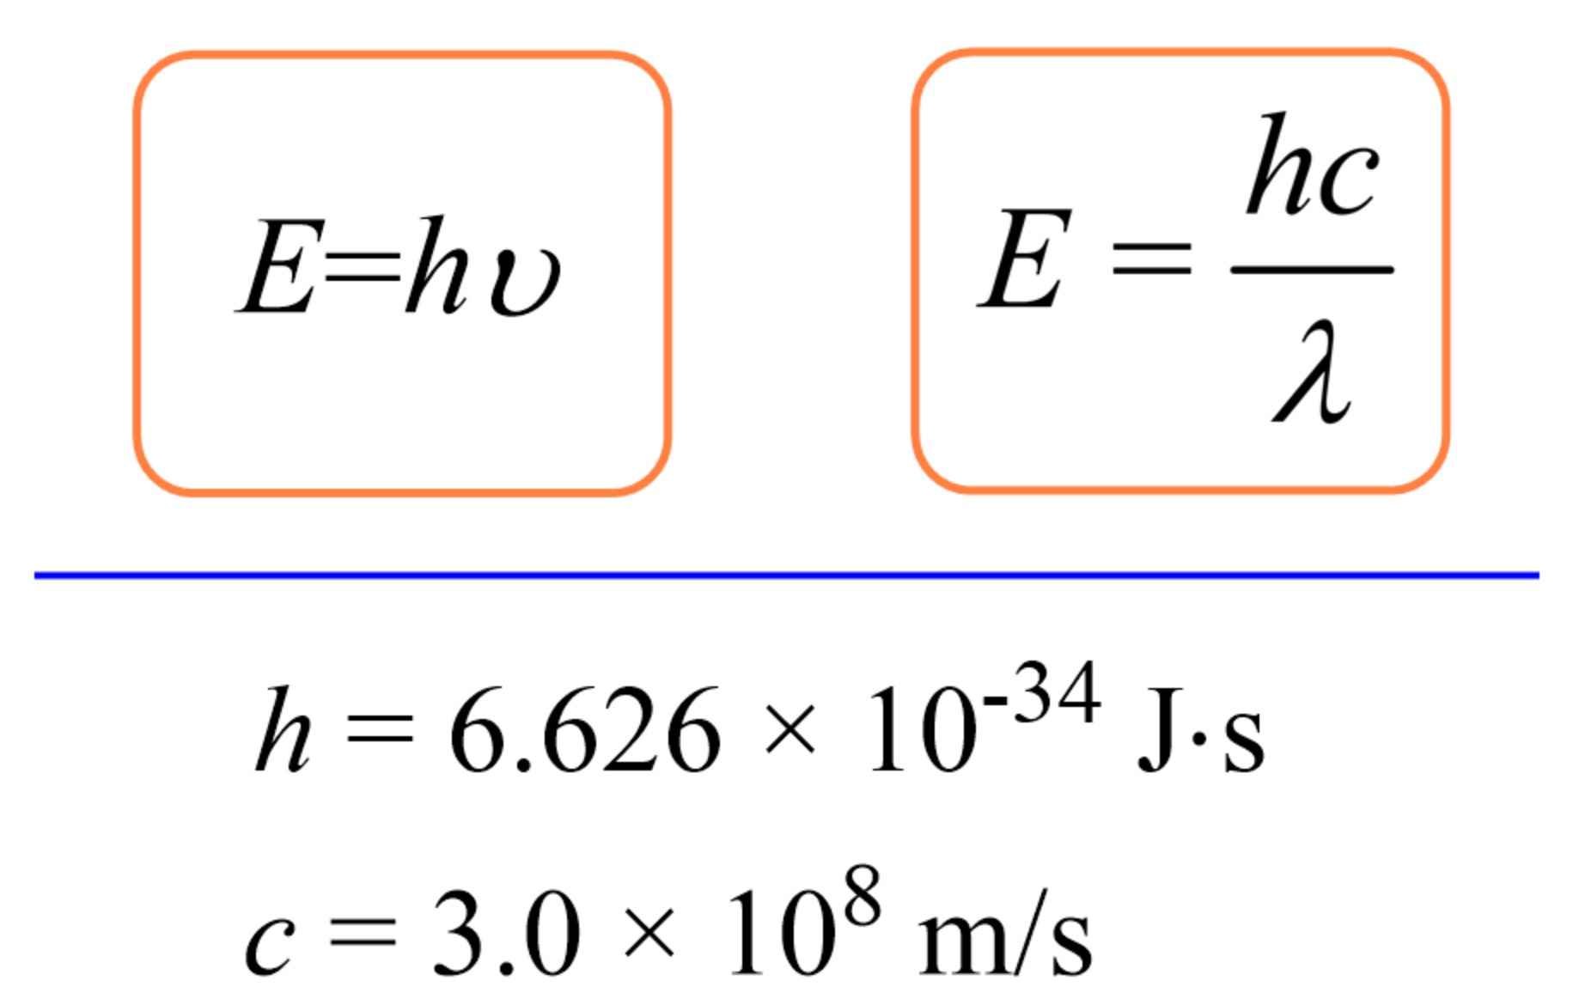
Different typs of electromagnetic radiation

Slide 11
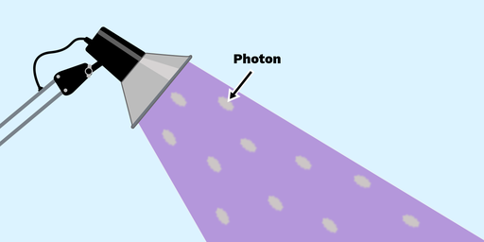
Light energy
Light emits photons (wavepacket of energy)
Each wavepacket contains energy
Formula E=hv gives you the energy of 1 photon (J/photon)
Q: How do I convert the units to J/(mol photon)

Slide 12
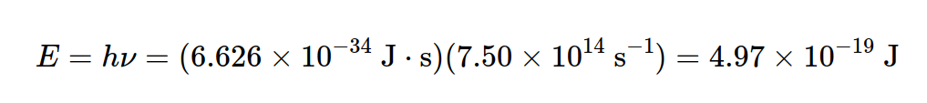
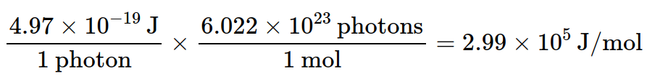
Example: energy of light
Violet light has a frequency of 7.50 x 10¹⁴ Hz. Calculate the energy of a single photon and a mole of photon.

Slide 13
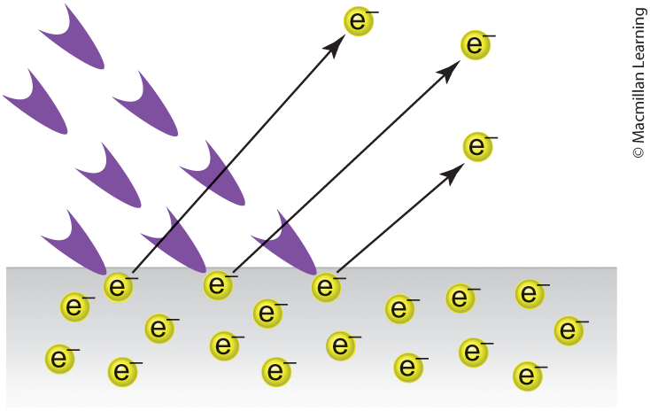
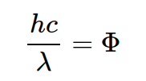
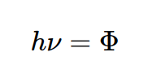
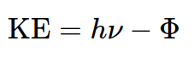
Photoelectric effect
When light energy hits a metal, electrons are ejected from the metal
Φ is the work function or minimal energy to eject an electron from the metal
Remaining energy is the kinetic energy (½ mv²)

Slide 14
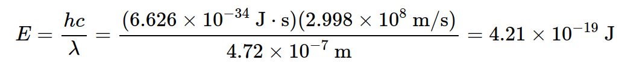
Example: photoelectric effect
What is the KE of the photoelectron that is produced when a blue photon with wavelength 472 nm strikes Sr metal in a vacuum? Work function is
4.15 x 10⁻¹⁹ J

Slide 15
Outline
Announcements
Ch. 8: Model of the Atom
Introduction to Light Energy
Bohr Model of the Atom
Heisenberg Uncertainty Principle
Atomic Orbitals and Quantum Numbers
Electron Configuration

Slide 16
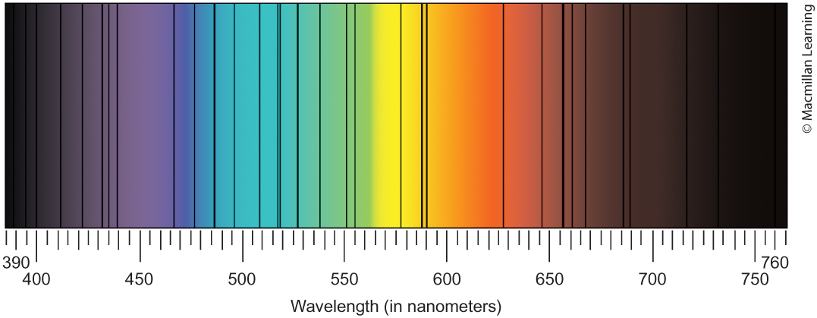
Ground and excited states
Ground state – lowest energy state of a particle
Excited state – higher energy state of a particle
Light energy absorption and emission – below is the sun emitting light

Slide 17
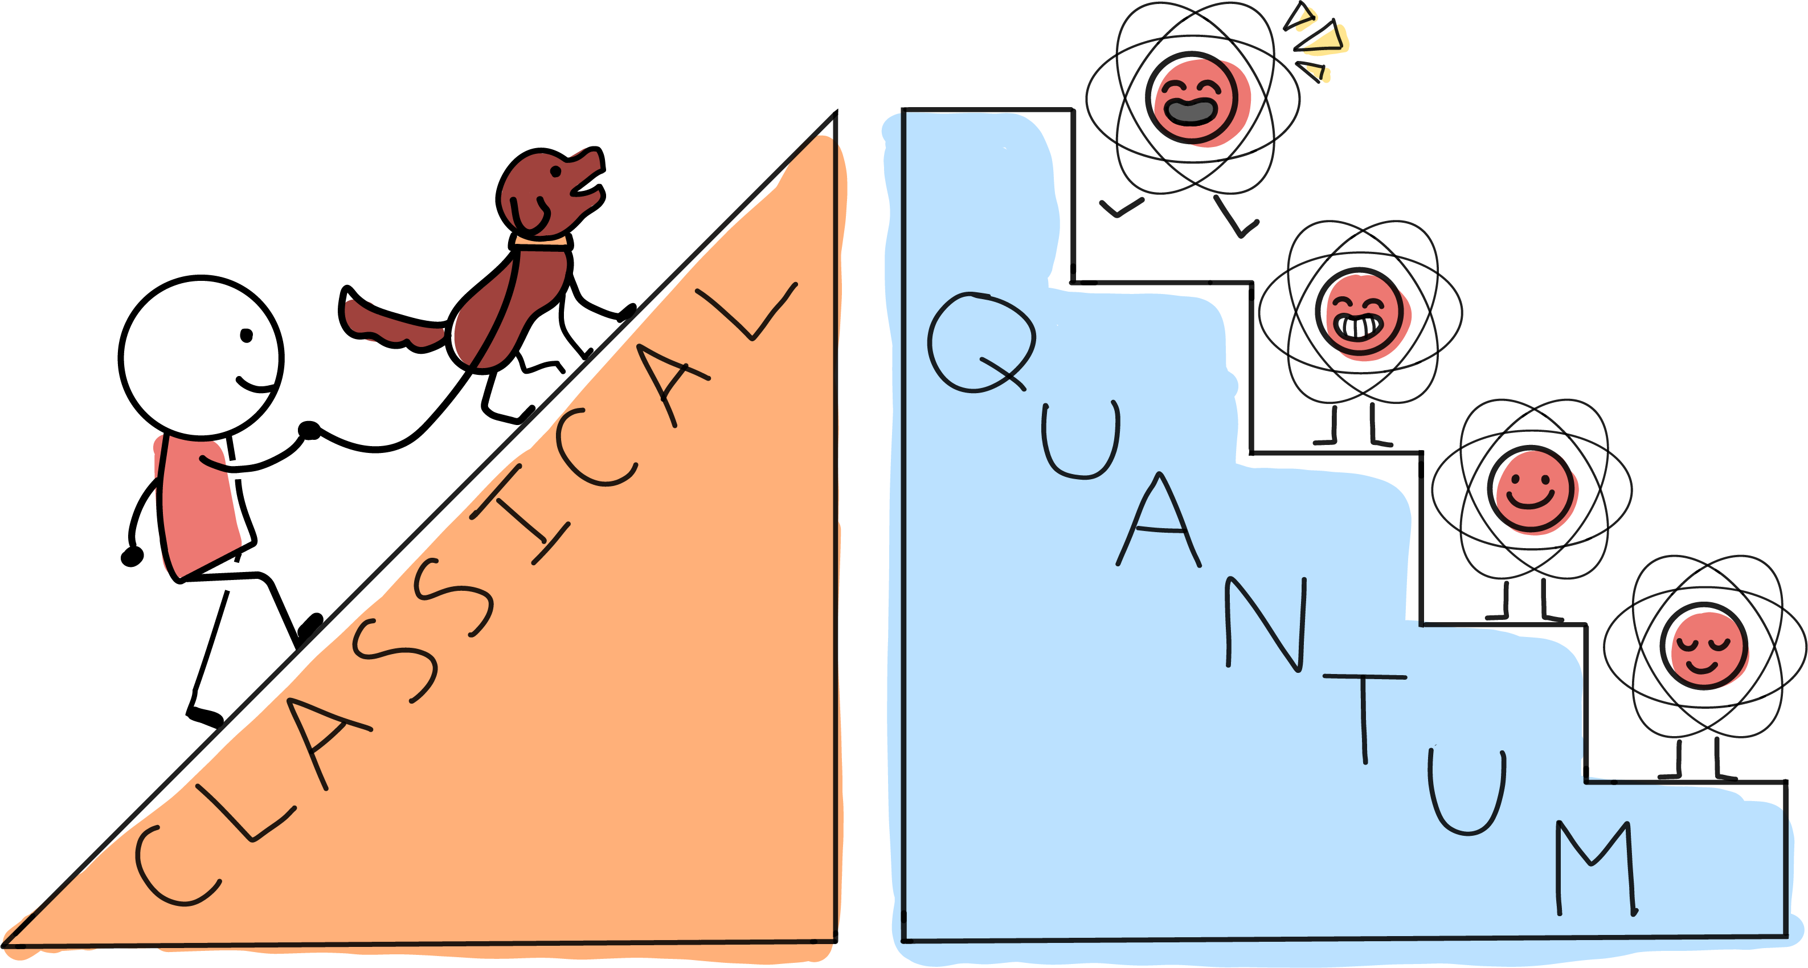
Classical and quantum picture of energy

Slide 18
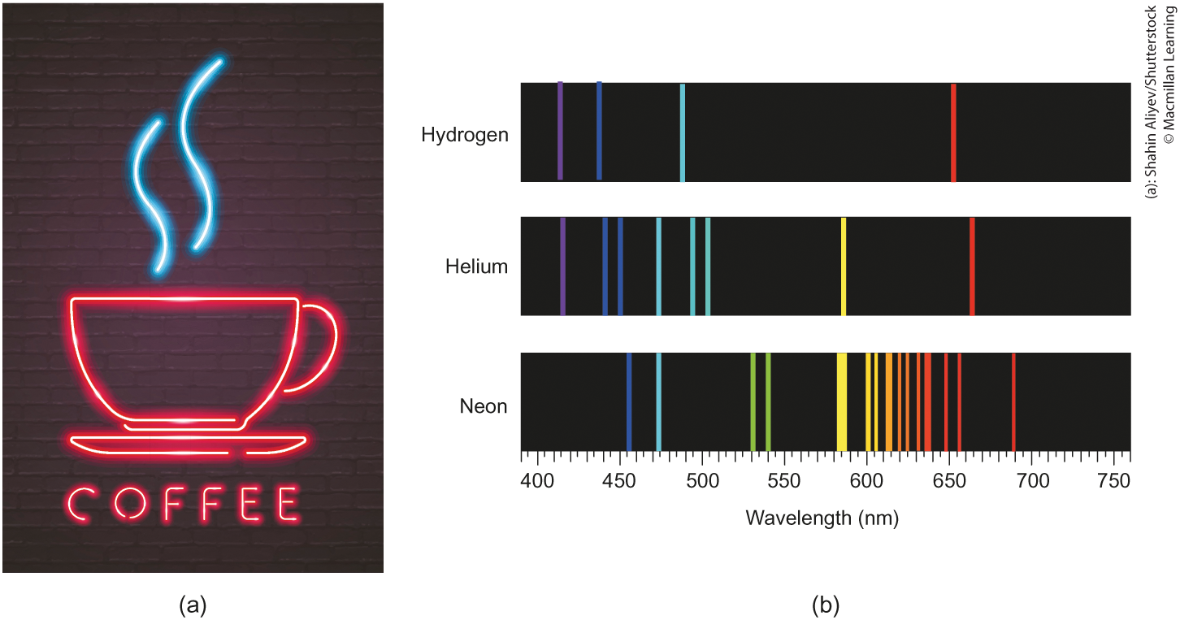
Discrete light emissions
Hydrogen, helium, and neon emits discrete light energy

Slide 19
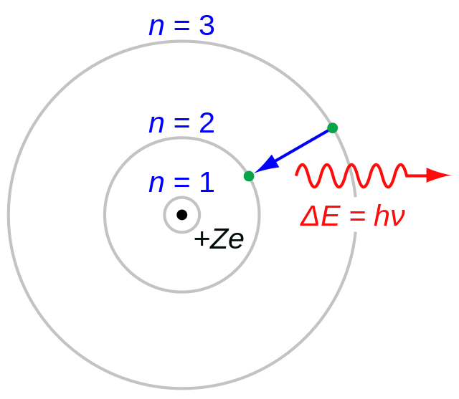
Bohr model of the atom
Singular proton of the hydrogen atom or the protons and neutrons of the hydrogen-like species(He⁺, Li²⁺, etc.)
Electron revolves around fixed circular paths of fixed radius and energy called stationary states
Energy of the electron changes only when it makes transitions from the energy level of one stationary state to the energy level of another stationary state (wavepacket)

Slide 20
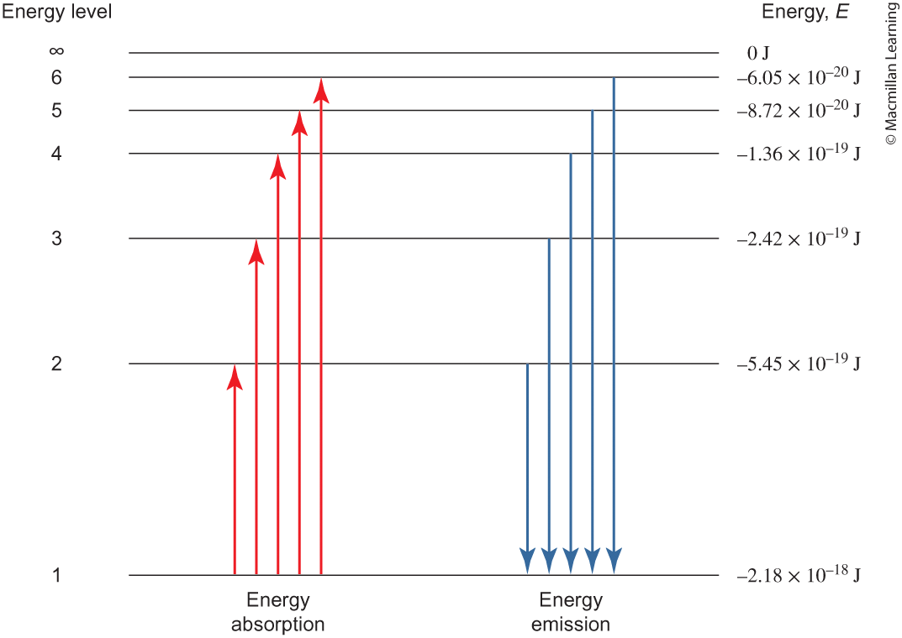
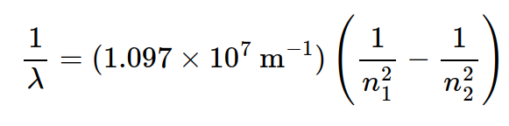
Energy levels and rydberg equation
n is the energy levels
λ is the wavelength (m)

Slide 21
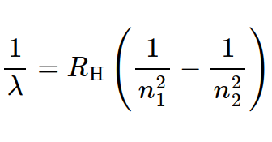
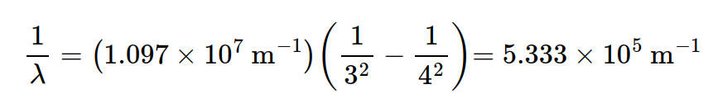
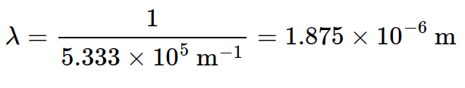
Example: Rydberg equation
Calculate the emission wavelength of a photon emitted from a hydrogen from n=4 to n=3.
Q: Can this emission wavelength be seen by the human eye?

Slide 22
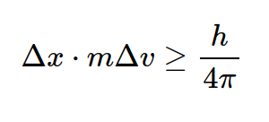
Limitation of the bohr model
Limited to only hydrogen-like atoms
Does not satisfy the Heisenberg uncertainty principle – cannot determine both the position and velocity of electron

Slide 23
Outline
Announcements
Ch. 8: Model of the Atom
Introduction to Light Energy
Bohr Model of the Atom
Heisenberg Uncertainty Principle
Atomic Orbitals and Quantum Numbers
Electron Configuration

Slide 24
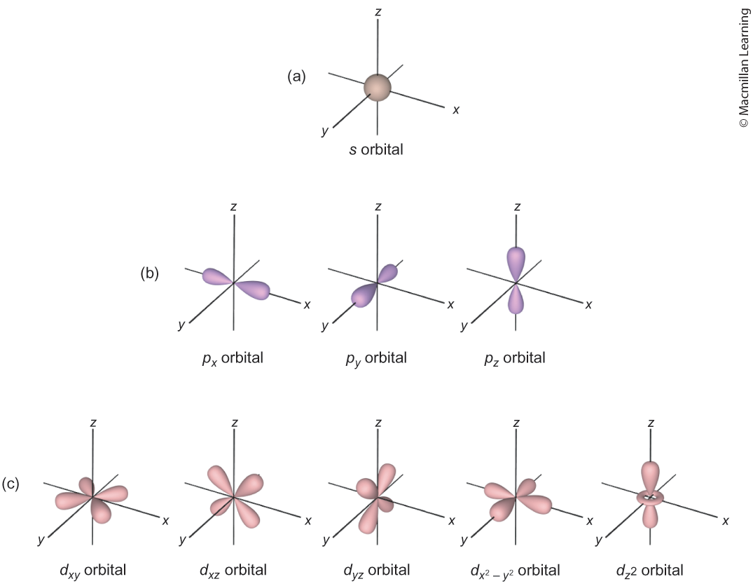
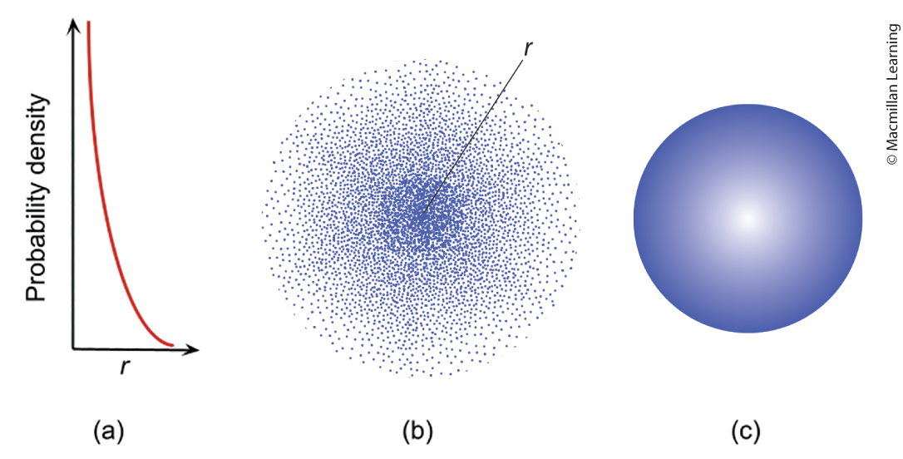
Atomic orbitals
Think of the position of electrons in term of probability

Slide 25
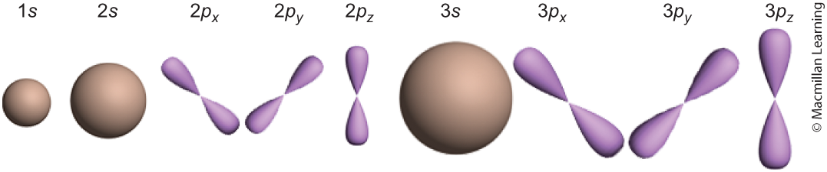
Quantum numbers – home address for electrons
Principal quantum number (n) - energy level
Angular momentum quantum number (l) - ranges between 0 … n-1, corresponds to the shape of the atomic orbital (l = 0 is s, l = 1 is p, etc.) or subshells
Magnetic quantum number (m_{l}) - individual orbitals within subshell ranges between –l,…, 0,…, +l
Magnetic spin quantum number (m_{s}) - electron spin +½ or –½

Slide 26
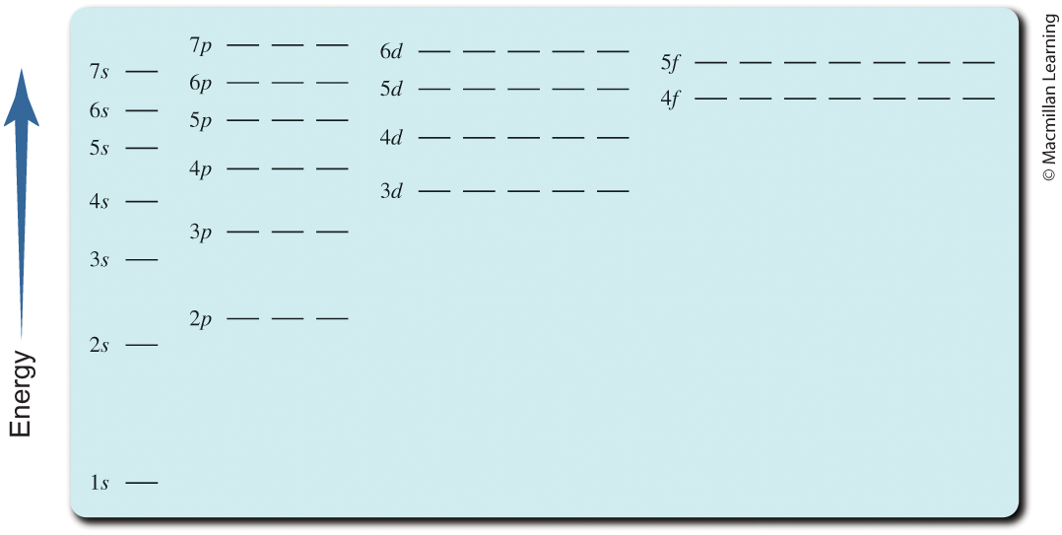
Atomic Orbital diagram

Slide 27
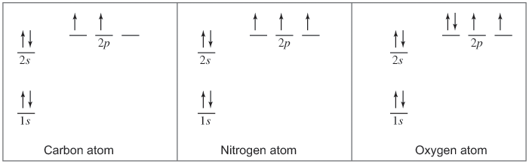
Filling in atomic orbitals with electrons
Aufbau Principle – Electrons in a ground-state atom always fill the lowest-energy position that is available
Hund's Rule – Maximize the total spin of the atom; half-filled and fully-filled atomic orbitals are preferred (lowest energy)

Slide 28
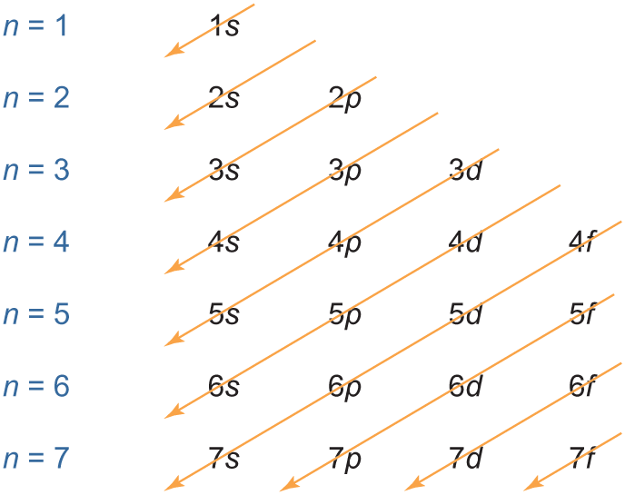
Orbital filling diagram tip

Slide 29
Outline
Announcements
Ch. 8: Model of the Atom
Introduction to Light Energy
Bohr Model of the Atom
Heisenberg Uncertainty Principle
Atomic Orbitals and Quantum Numbers
Electron Configuration

Slide 30
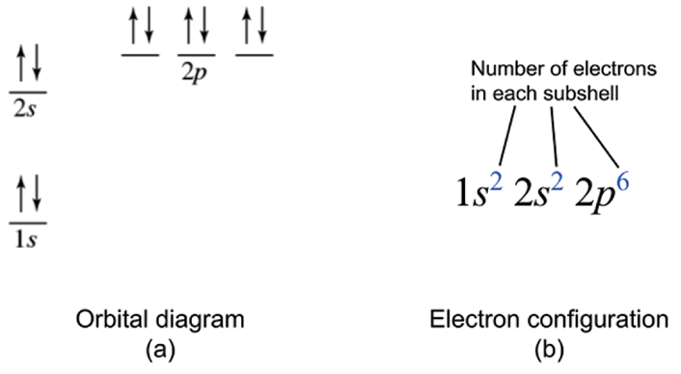
Electron configuration
Shows the arrangement of electrons in order of increasing energy

Slide 31
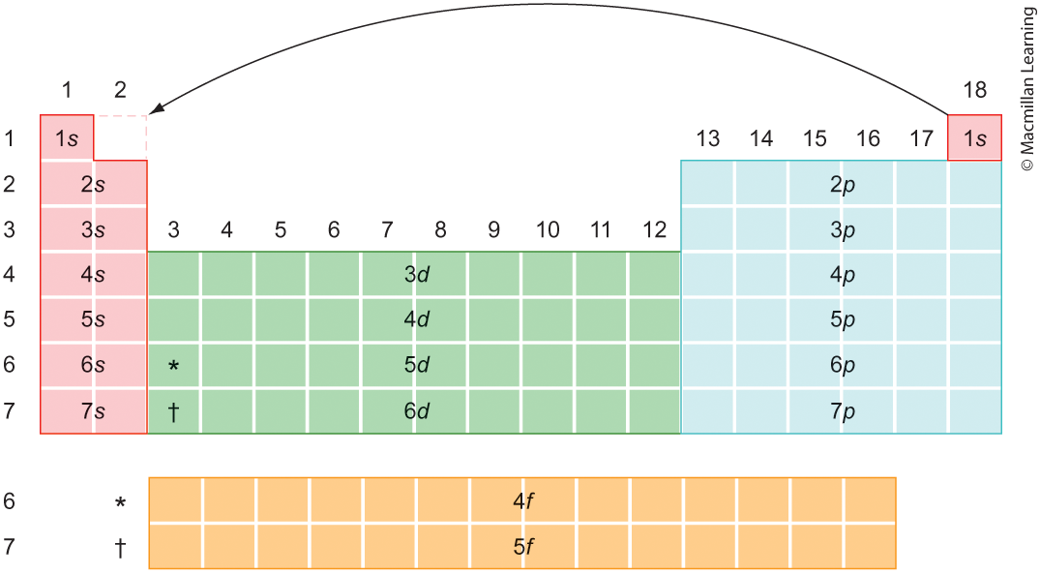
Electron configuration

Slide 32
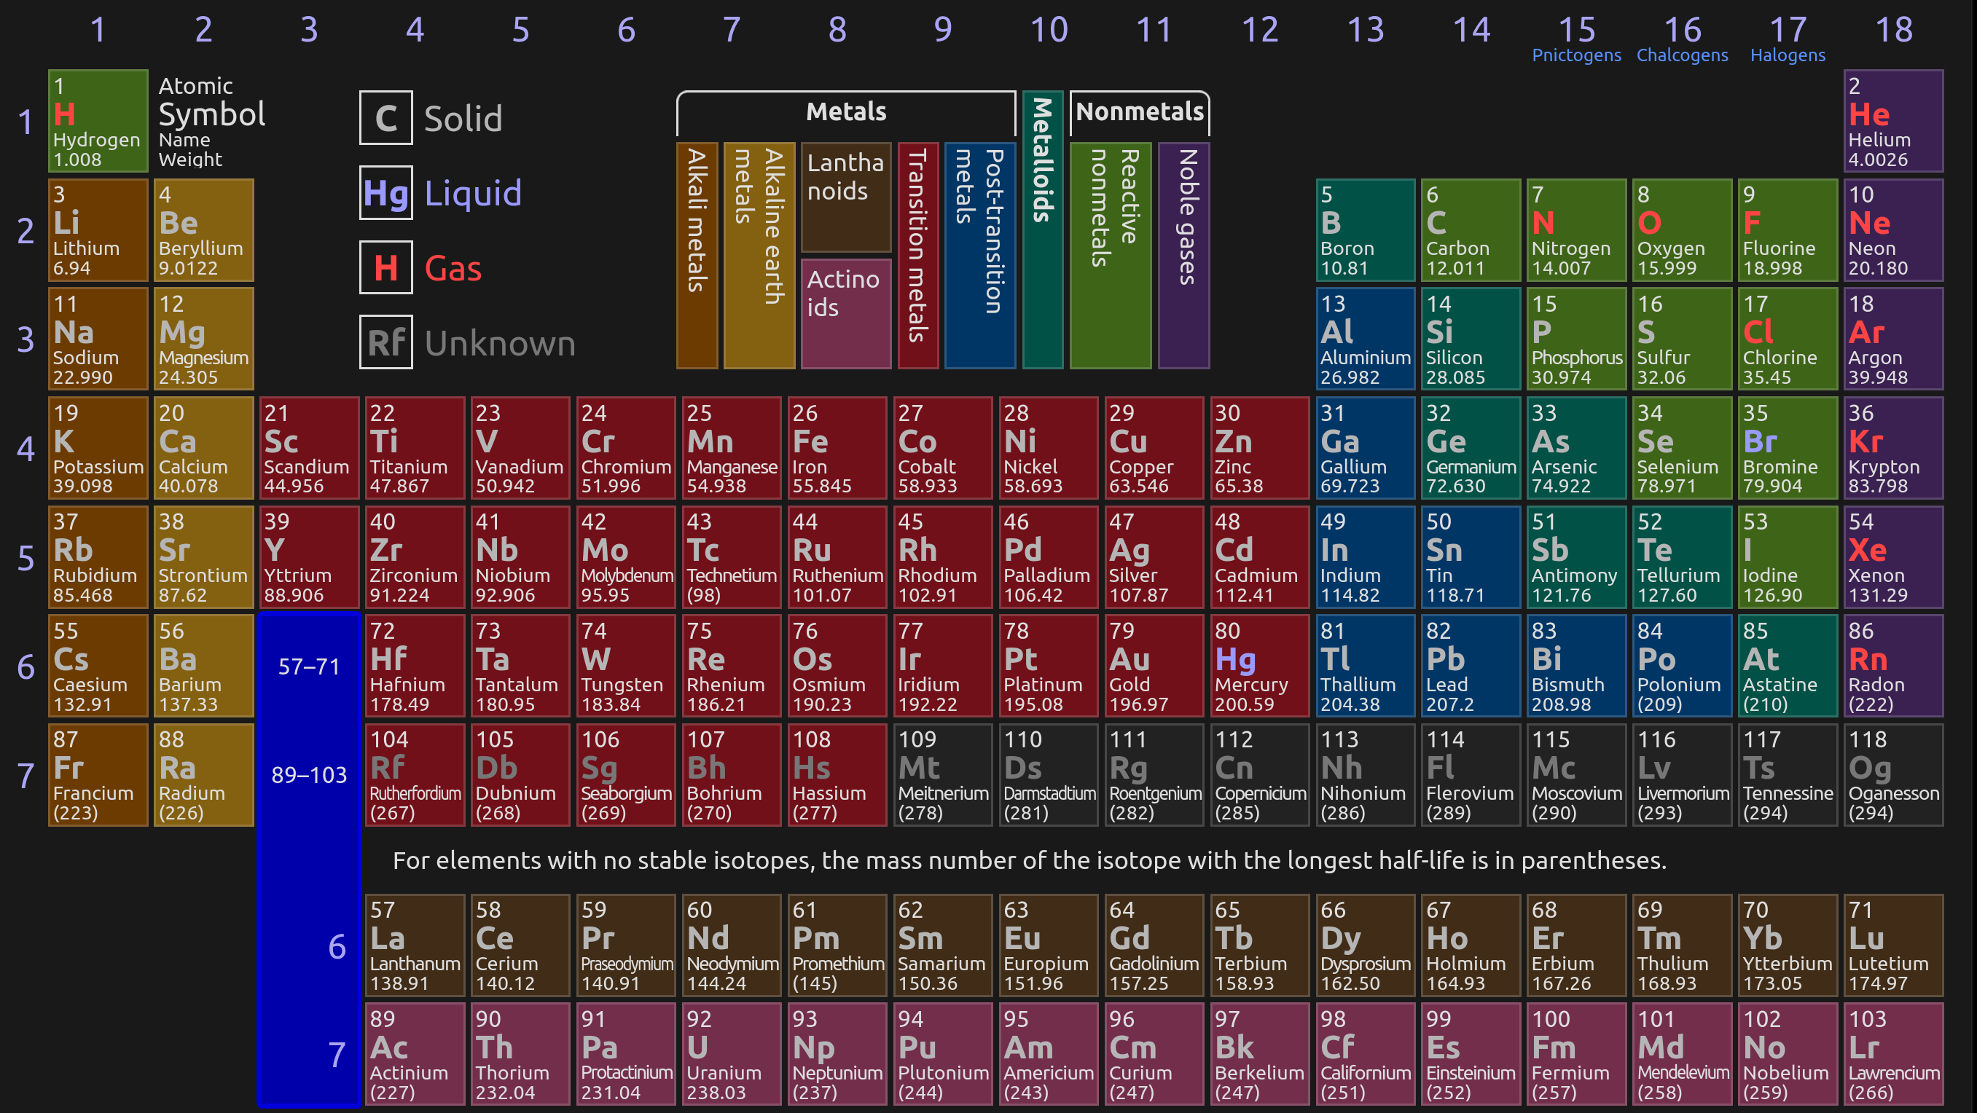
Periodic table – electron configuration

Slide 33
Your turn: determine the electron configuration of the following
He
N
P
Fe
Cr
Cu

